Slide 1
Silly Questions, Infinity, and Other Things
Farhad Arbab
Center for Mathematics and Computer Science (CWI), Amsterdam
and
Leiden Institute for Advanced Computer Science (LIACS), Leiden University
The Netherlands
23 January 2010

Slide 2
Stupidity
Stupidity
1 : the quality or state of being stupid
2 : a stupid idea or act
Stupid
Etymology: Middle French stupide, from Latin stupidus, from stupēre to be numb, be astonished
1:
a: slow of mind : obtuse
b: given to unintelligent decisions or acts : acting in an unintelligent or careless manner
c: lacking intelligence or reason : brutish
2: dulled in feeling or sensation : torpid <still stupid from the sedative>
3: marked by or resulting from unreasoned thinking or acting : senseless <a stupid decision>
4:
a: lacking interest or point <a stupid event>
b: vexatious, exasperating <the stupid car won't start>

Slide 3
Abundance of Stupidity
Only two things are infinite: the universe and human stupidity; and I'm not sure about the universe.
Albert Einstein
Never attribute to malice that which can be adequately explained by stupidity.
Any sufficiently advanced incompetence is indistinguishable from malice.

Slide 4
Aspects of Stupidity
Being stupid
Acting stupid
Feeling stupid

Slide 5
Being Stupid
Humans are not inherently stupid!
Inherently stupid individuals are statistically rare.

Slide 6
Acting Stupid
One does not have to be stupid to commit stupid acts!
Result of insufficient information and/or inadequately slow, unintelligent, careless, unfeeling, pointless, unreasoned thinking.
Reality
Perception
Often, something interferes with, disrupts, or blocks our inherent intelligence and rational thinking.
New external distress
Internalized distress
Most people are trained and conditioned to behave based on unreasoned or unintelligent thinking.

Slide 7
Feeling stupid
Feelings are there to be felt, not to determine our courses of action.
Get used to feeling stupid
Commit harmless acts of stupidity
It only feels bad, it is not the reality
you are not stupid, even if you committed a stupid act!
Seek, marvel at, and ponder what makes you feel stupid
In spite of your feeling, commit rational acts that only look and feel stupid

Slide 8
Stupidity is the Motor of Science
If people never did silly things, nothing intelligent would ever happen.
Ludwig J.J. Wittgenstein
He who thinks great thoughts, errs greatly.
Martin Heidegger
The importance of stupidity in scientific research, Martin Schwartz, J Cell Sci. 2008; 121:1771.

Slide 9
Homework
Find a copy of this paper and read it:
The importance of stupidity in scientific research, Martin Schwartz, J Cell Sci. 2008; 121:1771
Write an essay containing:
Critical summary of the above paper
Comparison with
your ideas on the subject
what you learn from this presentation
Write your name on a separate sheet
Double blind review process

Slide 10
Ignorance
Ignorance
The state or fact of being ignorant : lack of knowledge, education, or awareness
ignorant
1:
a: destitute of knowledge or education; also : lacking knowledge or comprehension of the thing specified
b: resulting from or showing lack of knowledge or intelligence
2: unaware, uninformed

Slide 11
Forms of Ignorance
Ignorance is bliss
What you do not know cannot hurt you.
But you have to be lucky to qualify!
Unaware ignorance
Aware ignorance
Deliberate ignorance
Deluding oneself
Ignoring the irrelevant: Abstraction
basis for mathematics!

Slide 12
Abstraction
Abstraction is a cognitive means to overcome complexity
Focus on essential features and suppress/ignore the rest.
A many-to-one mapping

Slide 13
Numbers
The first major advance in abstraction was the concept of numbers
Correspondence between elements of sets
The second was the use of numerals to represent numbers
Egyptians had a powerful system with hieroglyphs for 1 to 10.
Babylonians had a place value system.

Slide 14
The Concept of Number
Consider a set of men and a set of beads.
If each man has a single bead and each bead belongs to a single man, we have a one-to-one correspondence between (the elements of) these two sets.
All sets that have such a one-to-one correspondence with these sets have the same size.
A number is an abstraction of all these sets, ignoring all of their properties except their common size.
Numerals are symbols that represent numbers
We commonly use the base-10 place-value system

Slide 15
Natural Numbers
Historically:
1, 2, 3, 4, …
Since late 19th century:
0, 1, 2, 3, …
Counting is establishing a one-to-one correspondence between (the elements of) a set and (the elements of the set of) natural numbers.

Slide 16
Puzzle
10 bags of identical looking gold coins
Every coin in 9 bags weighs 100 grams
Every coin in one bag weighs 90 grams
Determine which bag contains defective coins using a single scale only once.

Slide 17
Arithmetic
Natural numbers have been used in arithmetic for millennia,
Until 19th century, it was not clear why some of the properties of arithmetic and natural numbers hold.

Slide 18
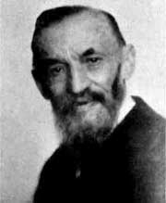
Giuseppe Peano
Born: 27 August 1858 Spinetta, Piedmont, Italy
Died: 20 April 1932 (aged 73)

Slide 19
Peano Axioms
Giuseppe Peano formal theory of the natural numbers:
There is a natural number 0.
Every natural number a has a natural number successor, denoted by S(a). Intuitively, S(a) is a+1.
There is no natural number whose successor is 0.
Distinct natural numbers have distinct successors: if a ≠ b, then S(a) ≠ S(b).
If a property is possessed by 0 and also by the successor of every natural number which possesses it, then it is possessed by all natural numbers. (This postulate ensures that the proof technique of mathematical induction is valid.)

Slide 20
Infinity
How large is the set of natural numbers?
How large are other sets?
Subsets of natural numbers
Set of all integers
Sets of subsets of natural numbers or integers
Set of real numbers
Etc.
Is infinity itself a number?
Can we use it in place of a number in arithmetic?
Are all infinite sets the same size?

Slide 21
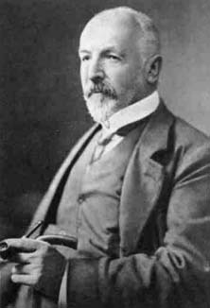
Georg Ferdinand Ludwig Phillip Cantor
Born: March 3, 1845 Saint Petersburg, Russia
Died: January 6, 1918 (aged 72) Halle, Germany
Creator of set theory
Importance of one-to-one correspondence
Defined infinite sets
Showed their seemingly paradoxical properties
Different orders of infinity (cardinality)
Integers are countably infinite, but real numbers are uncountably infinite

Slide 22
Properties of Infinity
How large is the set of natural numbers starting with 0?
How large is the set of natural numbers starting with 1?
How large is the set of natural numbers starting with 10?
How large is the set of odd natural numbers?
How large is the set of even natural numbers?
How large is the set of integers?

Slide 23
Infinity of Real Numbers
How many real numbers are there between, say 0 and 1?

Slide 24
Puzzles
Muddy children 1
Muddy children 2

Slide 25
A Rock Too Big to Lift!
Can mathematics devise ways to answer any question we can express in the language of logic?
In early 20th century, mathematicians believed the answer was yes!

Slide 26
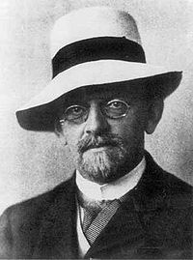
David Hilbert
Born: January 23, 1862 Königsberg or Wehlau, Province of Prussia
Died: February 14, 1943 (aged 81) Göttingen, Germany
Proposed in 1920 his program for mathematics:
Formulate all of mathematics on a solid and complete logical foundation
He believed this was possible in principle by
Choosing a correct finite set of axioms
Proving that the axioms are consistent

Slide 27
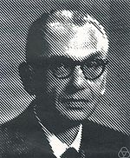
Kurt Gödel
Born: April 28, 1906 Brno, Moravia, Austria-Hungary
Died: January 14, 1978 (aged 71) Princeton, New Jersey, U.S.
In 1931 demonstrated that any non-contradictory formal system, comprehensive enough to include at least arithmetic, cannot demonstrate its completeness by way of its own axioms.
There are true statements that cannot be derived from the (finite) axioms of the system.
Hilbert's grand plan was impossible!

Slide 28
Problems and Solutions
In its simplest form, a problem is a question about some input, that has a yes/no answer:
Given the numbers x and y is x the square root of y?
Given an integer x, is x an even number?
The solution to a problem is an algorithm that is guaranteed to terminate in finite time and provides the proper yes/no answer.
A problem for which a solution exists is called decidable.
Are all problems decidable?

Slide 29
Termination of Programs
Terminating program:
print “hello world!”
Non-terminating program:
while true continue
Termination can depend on input:
read x
if x = “hello!” then print “hello world!”
else while true continue

Slide 30
Halting Problem
Can we write a program h(p, i) to determine if program p will halt on input i?
No, this is impossible!
One of the first instances of concrete undecidable (provably unsolvable) problems.
Many other problems are shown to be unsolvable by reduction to the halting problem.

Slide 31
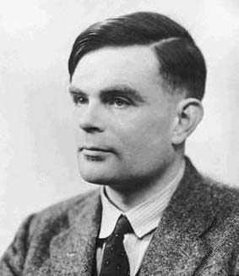
Alan Mathison Turing
Born: 23 June 1912 Maida Vale, London, England
Died: 7 June 1954 (aged 41) Wilmslow, Cheshire, England
WWII hero code breaker
Pioneered computer science
Turing machine: computability
Turing test: can machines think?
Undecidability of halting problem
Etc.

